Slide 1
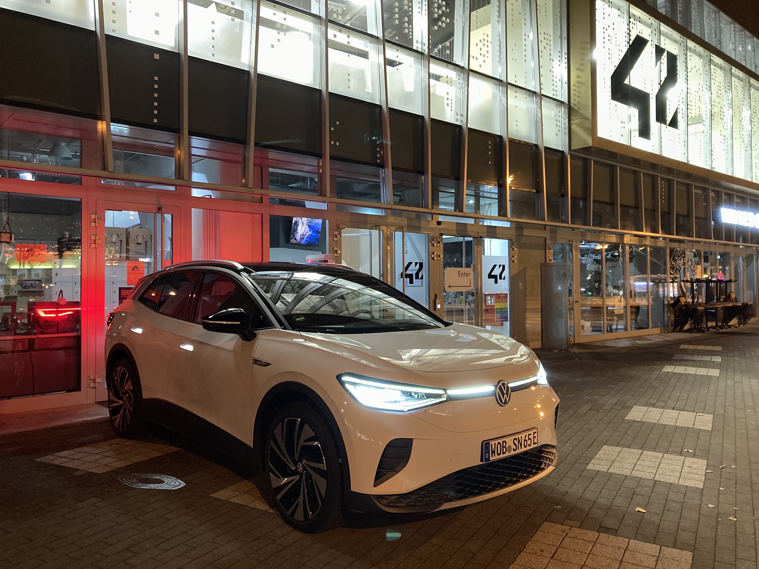
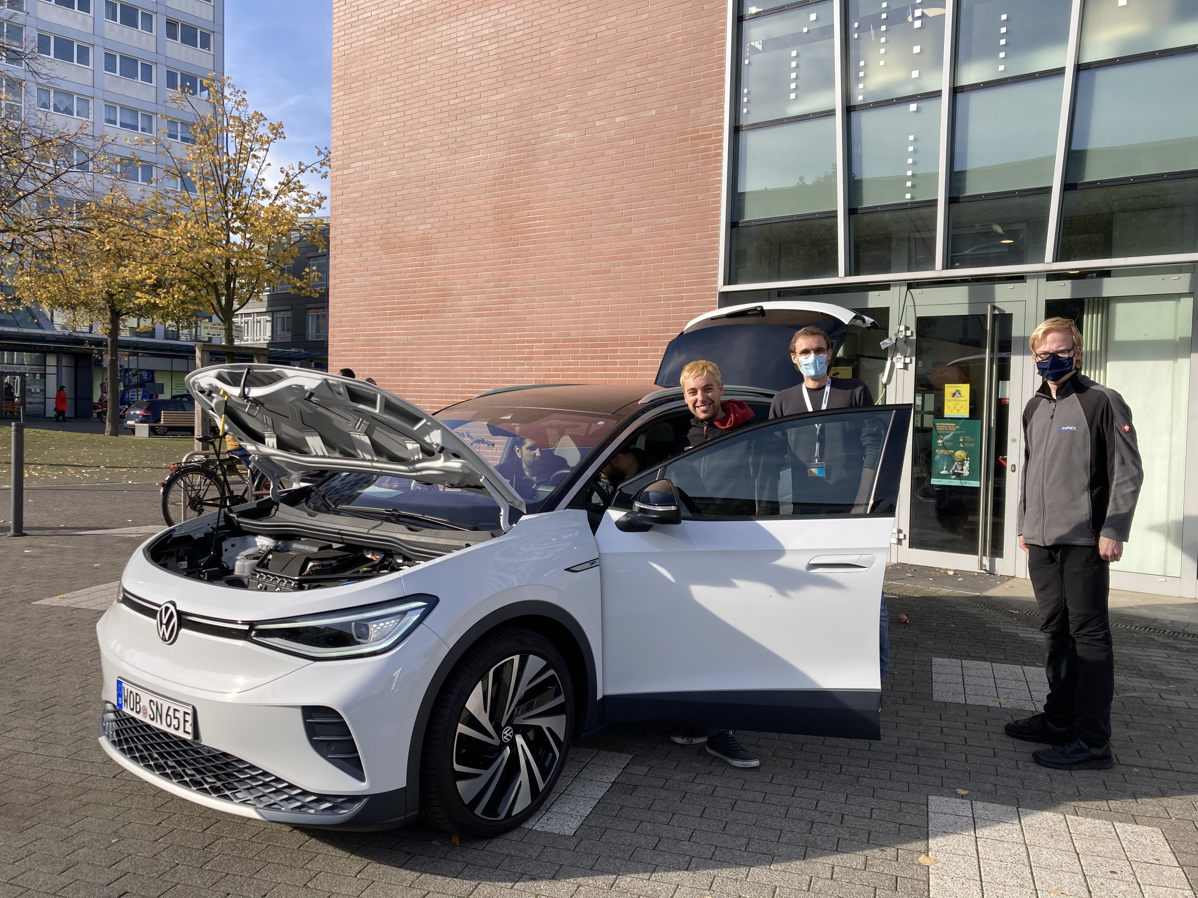
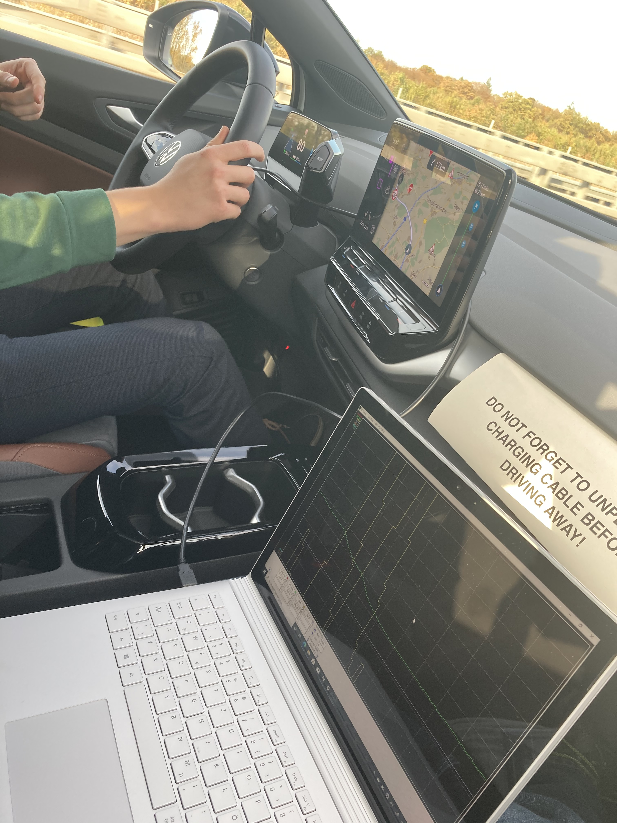
VW ID.4 Test Drive
Datalogging & Analysis
25th – 26th October 2021

Slide 2
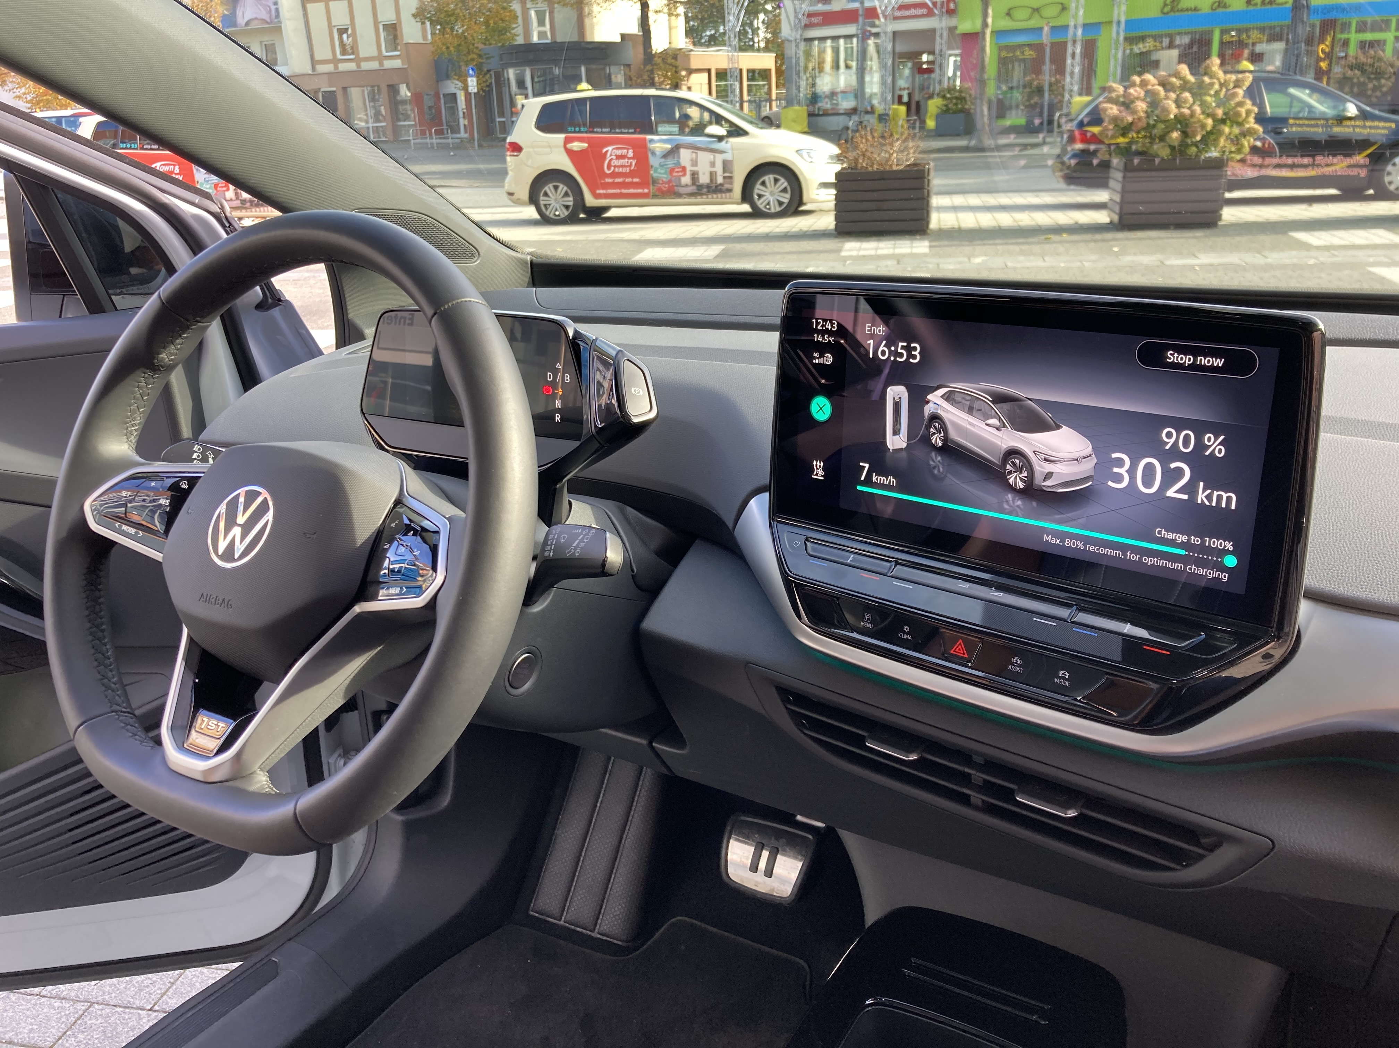

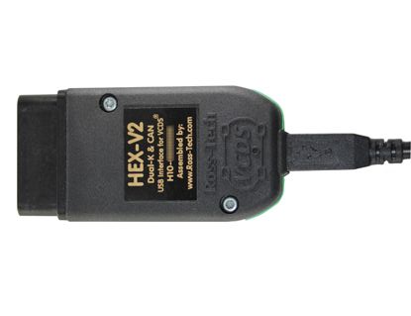
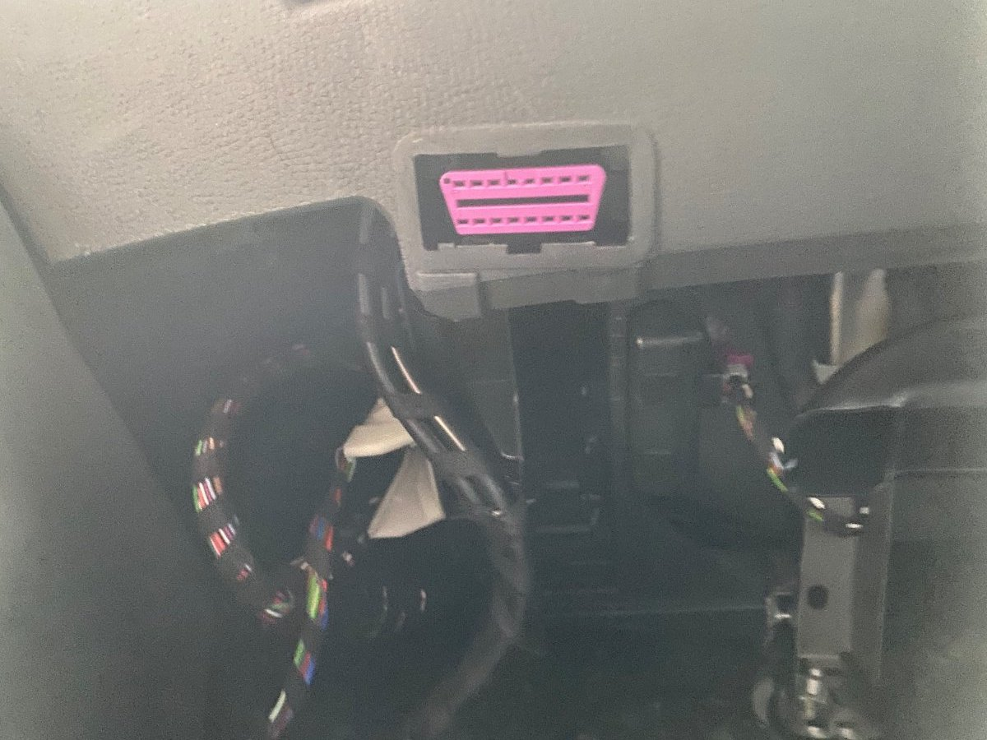
How to record data from the ID.4? We use a device called “On-Board-Diagnostic (OBD) Tester“ which we connect to the OBD port of the car and to a Windows PC. We can then record signals from any Electronic Control Unit (ECU ) of the car.
Car
Ready for testing!
Plug the OBD Tester into the OBD port of car
Plug the OBD Tester into USB port of PC
OBD port
OBD Tester
Windows PC
Notes:
Ideas - who else do we need:
Consulting companies (?)
Deloitte: Tobias
Bearing Point: Tobias
Accenture: ?
McK: ?
Tech companies
IBM
Microsoft
SAP
Startups
Unicorns
Personio?
Deep Tech
Merantix?

Slide 3
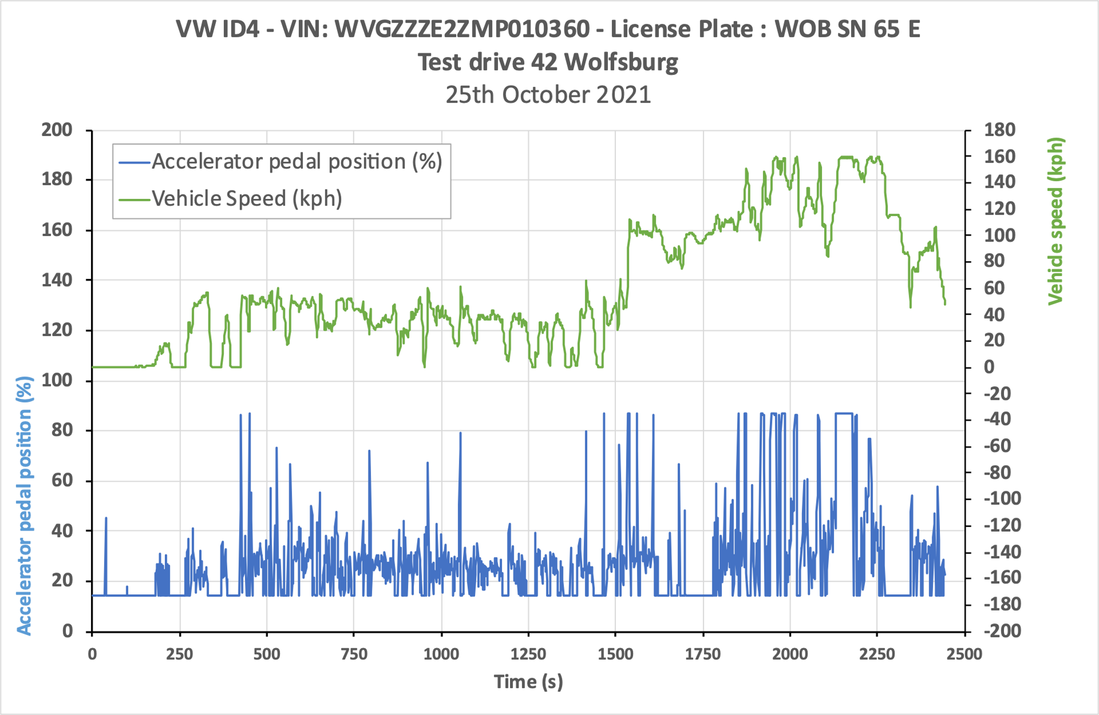
Maximum Vehicle Speed Test*
The signals come from the Powertrain ECU.
The maximum vehicle speed of the ID.4 is 160kph.
The accelerator pedal position varies between 15% (pedal at rest position) and 84% (pedal fully depressed). There may be another signal that is scaled to 0-100% value.
Max Speed = 160kph
84%
15%
*Test performed on unrestricted Autobahn.

Slide 4
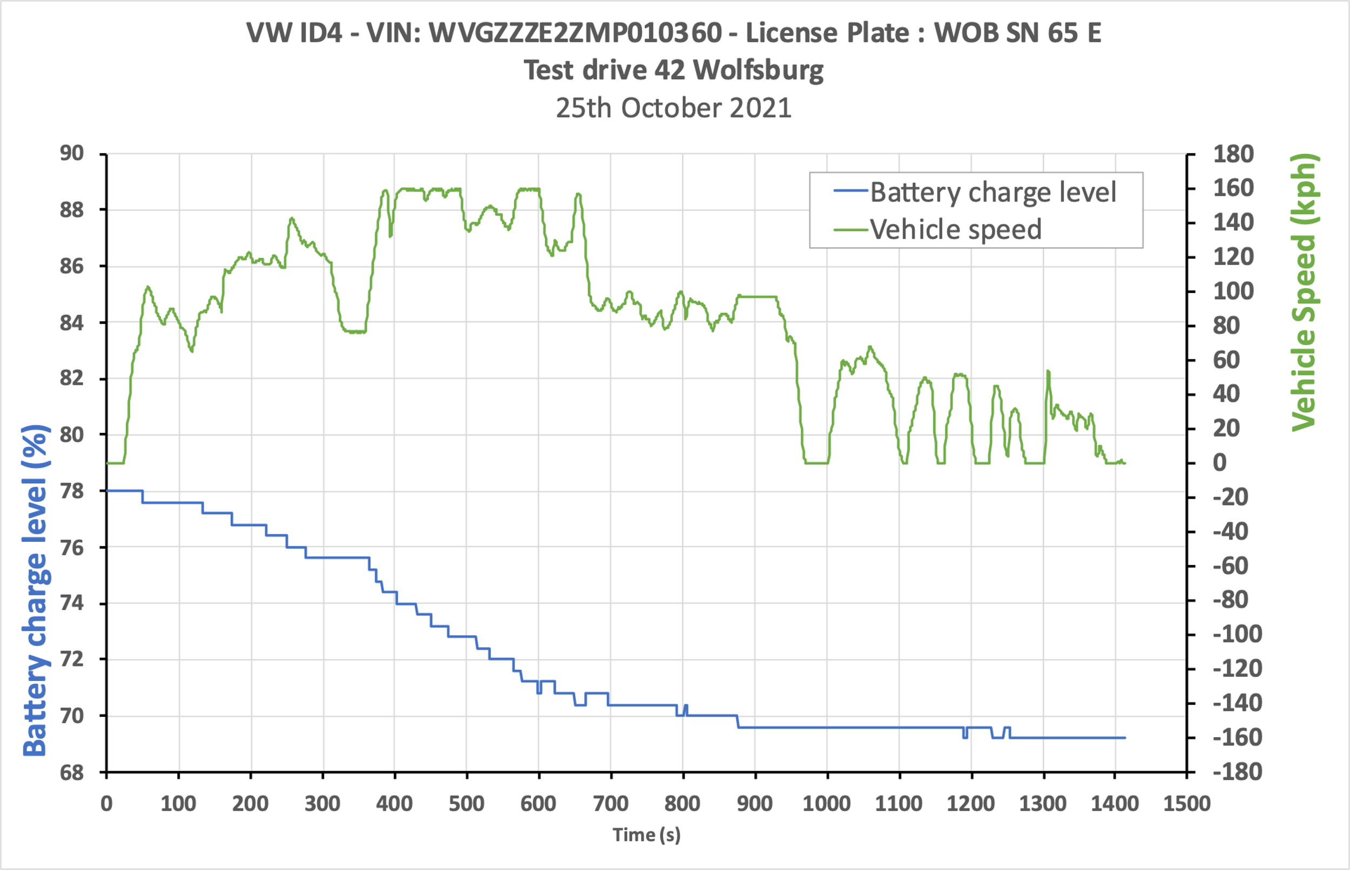
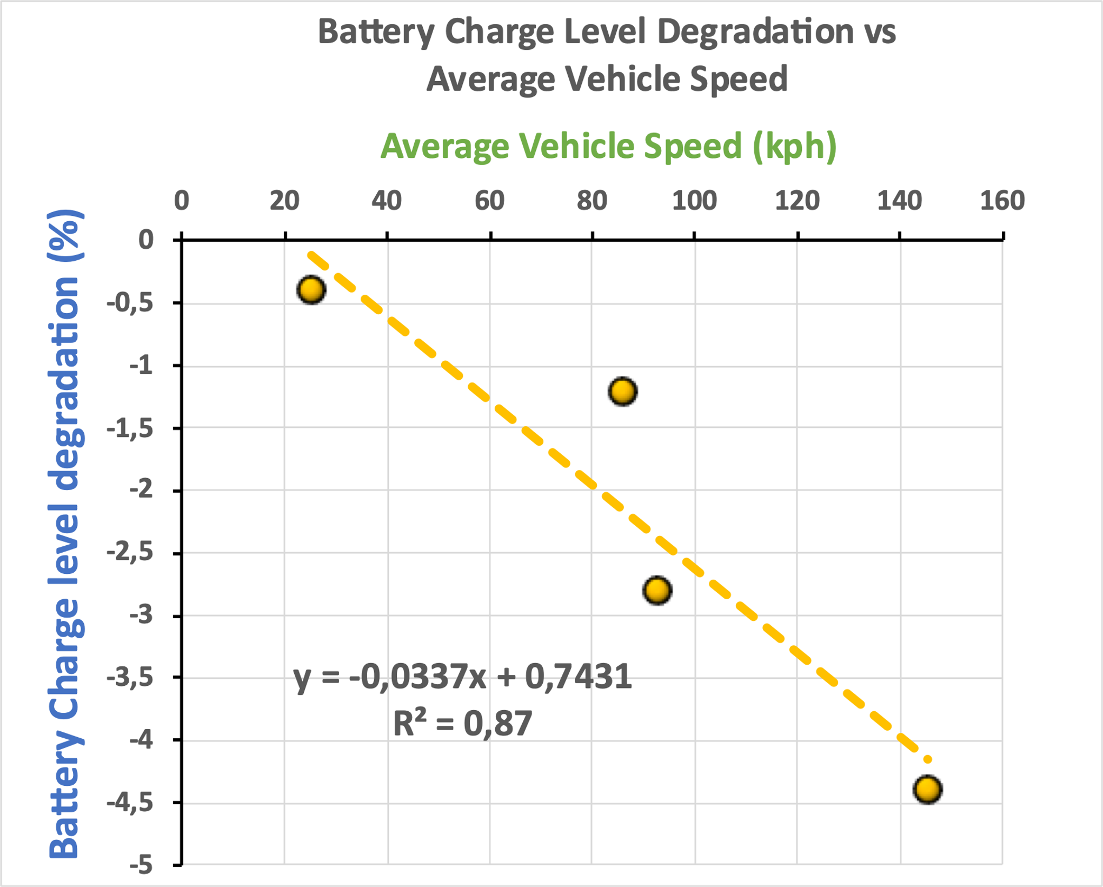
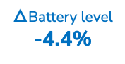
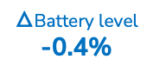
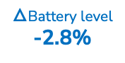
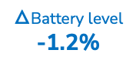
Battery charge level evolution vs Driving profile
The signals come from the High Voltage Battery ECU.
The battery charge level decreases with the average vehicle speed :
Avg Speed
93kph
Avg Speed
145kph
Avg Speed
86kph
Avg Speed
25kph
78%
75.2%
$△$Battery level
-2.8%
$△$Battery level
-1.2%
$△$Battery level
-0.4%
$△$Battery level
-4.4%
70.8%
69.6%
Other factors which influence Battery charge level: regeneration, A/C, use of accessories etc.
69.2%
Express Way
Motorway
Express Way
City
Time (s)

Slide 5
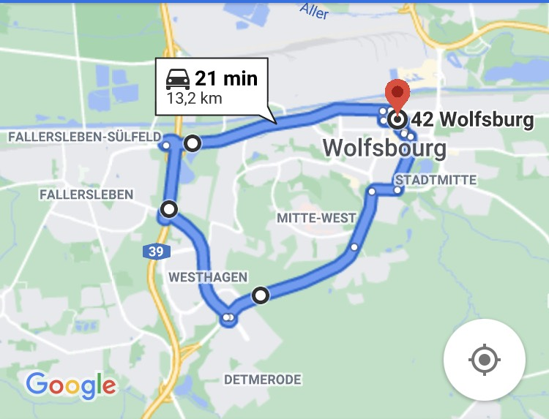
Comparison of 3 drivers on same itinerary
 |  | Driver 1 | Driver 2 | Driver 3
Mileage | km | 12 | 13 | 12
Average Vehicle Speed | km/h | 24 | 22 | 28
Duration | min | 31 | 34 | 27
Electricity consumption | kWh/100km | 18,2 | 18,4 | 17,9
The test were done with the same vehicle parameters :
Gear in B (regenerative braking) / Vehicle mode = Comfort / Air Conditioning = OFF.

Slide 6
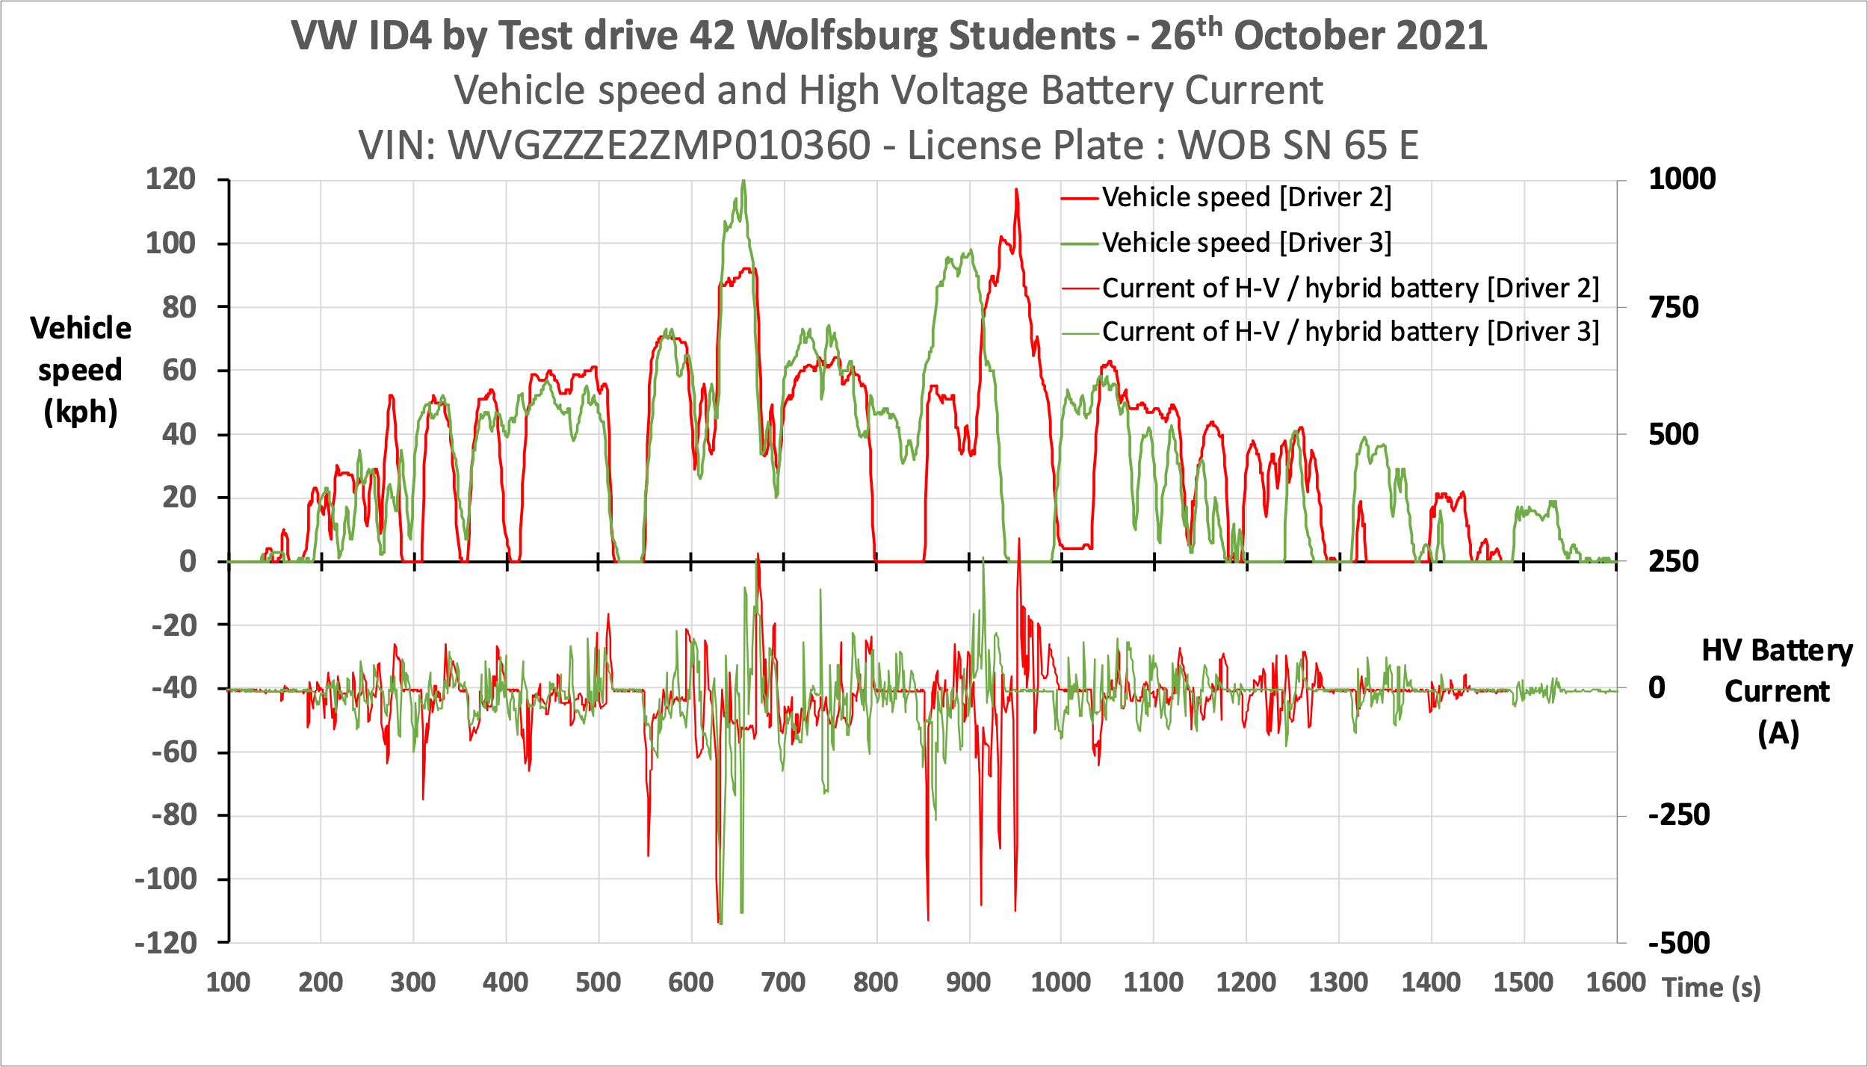
Comparison of Driver 2 and Driver 3
When electric current is positive, the energy of the battery is regenerated from the kinetic energy of the vehicle (inertia).
When electric current is negative, the energy of the battery is consumed to propel the vehicle.
Electricity consumption is higher for Driver 2 because he has more sharp acceleration requests than Driver 3 → Eco coaching to help driver save range?
Current > 0
Regeneration
Current < 0
Consumption

Slide 7
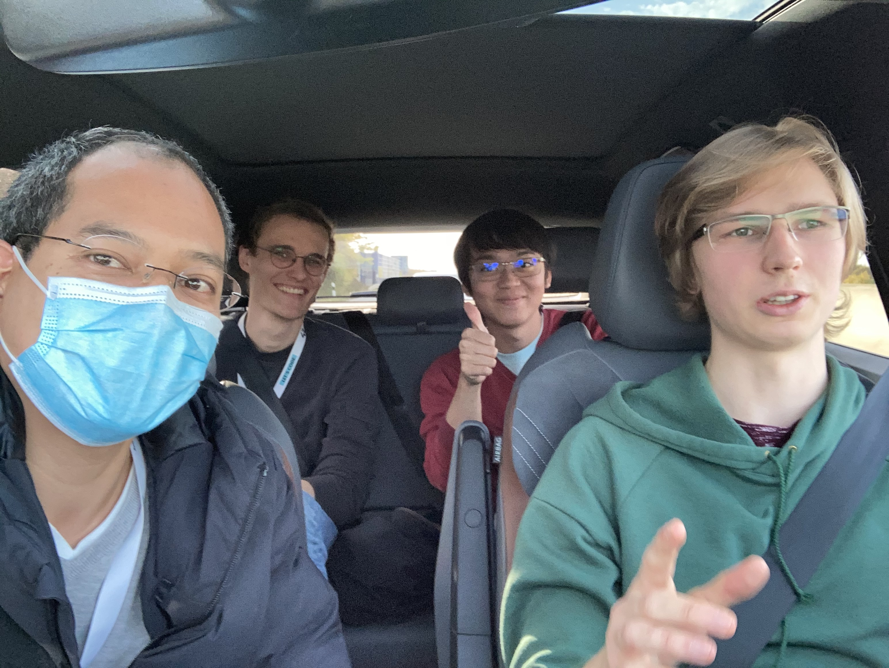
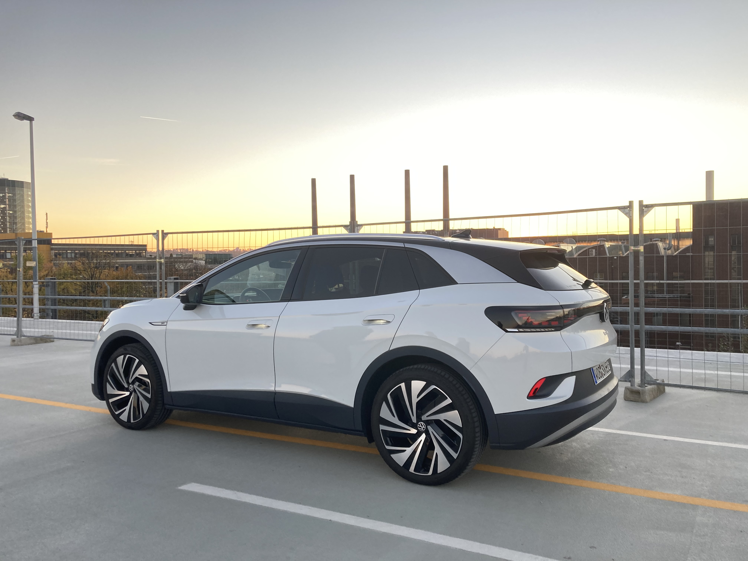
Any questions?

